Slide 1
Inventory management
Chapter # 12

Slide 2
Learning outcomes
Get some knowledge about inventory systems of a company
Cost associated with inventory
Good or Bad inventory
Purchasing decisions:
When should we buy or order a new item, How many quantities
Should we really accept or reject a discount offer from suppliers

Slide 3
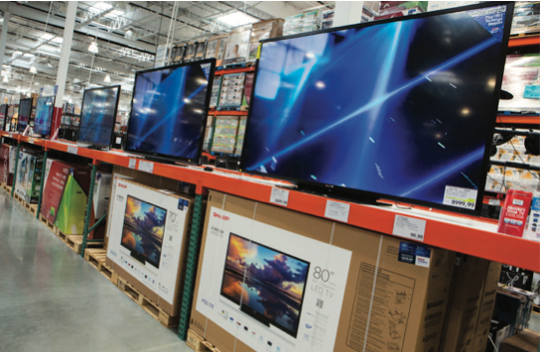
Inventory management
Inventory management is a core operations management activity.
Effective inventory management is important for the successful operation of most businesses and their supply chains, and impacts operations, marketing, and finance.
Poor inventory management, however, hampers operations, diminishes customer satisfaction, and increases operating costs.
Some organizations have excellent inventory management, and many have satisfactory inventory management. Too many, however, have unsatisfactory inventory management. They either have too little or too much inventory, inaccurate inven- tory tracking, or incorrect priorities. What is lacking is an understanding of what needs to be done and how to do it. This chapter presents the concepts and knowledge base for effective inventory management.

Slide 4
Introduction
 An inventory is a stock or store of goods.
 Firms typically stock hundreds or even thousands of items in inventory, ranging from small things such as pencils, paper clips, screws, nuts, and bolts to large items such as machines, trucks, construction equipment, and airplanes.
 Naturally, many of the items a firm carries in inventory are related to the business it engages in.
 Thus, manufacturing firms carry supplies of raw materials, purchased parts, partially finished items, and finished goods, as well as spare parts for machines, tools, and other supplies.
 Department stores carry clothing, furniture, carpeting, stationery, cosmetics, gifts, cards, and toys.

Slide 5
Introduction (contd.)
 Some also stock sporting goods, paints, and tools.
 Hospitals stock drugs, surgical supplies, life-monitoring equipment, sheets, and pillow cases, and more.
 Supermarkets stock fresh and canned foods, packaged and frozen foods, household supplies, magazines, baked goods, dairy products, produce, and other items.
 The amounts and dollar values of inventories carried by different types of firms vary widely, a typical firm probably has about 30 percent of its current assets and perhaps as much as 90 percent of its working capital invested in inventory.

Slide 6
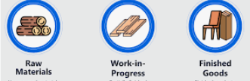

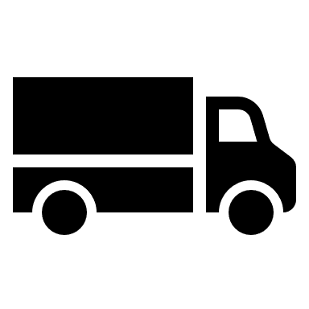

Types of inventories
Types of inventories include the following:
◎ Raw materials and purchased parts
◎ Partially completed goods, called work-in-process (WIP)
◎ Finished-goods inventories (manufacturing firms) or merchandise (retail stores)
◎ Tools and supplies (Equipment, screw, hammer, etc)
◎ Maintenance and repairs (MRO) inventory (Machine spare parts)
◎ Goods-in-transit to warehouses, distributors, or customers (pipeline inventory)
Both manufacturing and service organizations have to consider the space requirements of inventory. In some cases, space limitations may restrict inventory storage capability, thereby adding another dimension to inventory decisions.
Tools & supplies,
MRO
Pipeline

Slide 7
Types of inventories
Inventory that is intended to meet expected demand is known as cycle stock, while inventory that is held to reduce the probability of experiencing a stockout (i.e., running out of stock) due to demand and/or lead time variability is known as safety stock.
The risk of shortages can be reduced by holding safety stocks, which are stocks in excess of expected demand to compensate for variabilities in demand and lead time.
Anticipation stocks are those stocks that are held to satisfy expected (i.e., average) demand.

Slide 8
Types of inventories
In addition, intermediate stocking of goods - including raw materials, semifinished items, and finished goods at production sites, as well as goods stored in warehouses - leads to pipeline inventories throughout a production-distribution system.

Slide 9
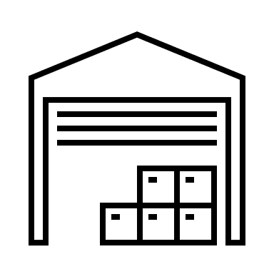
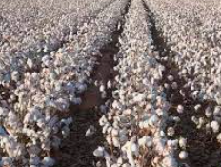
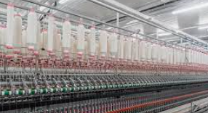
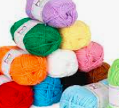
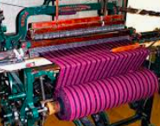
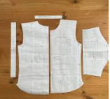
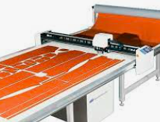

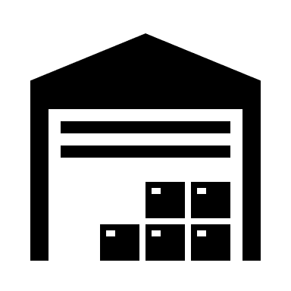
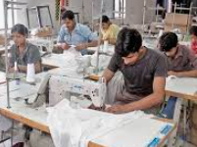

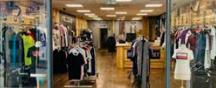
Why we need inventories
Raw material inventory
Raw material
WIP inventory
WIP inventory
WIP inventory
Finish goods inventory
Finish goods inventory

Slide 10

Why we need inventories
Still Supply
No supply
Raw material inventory
Raw material
WIP inventory
Still Supply
Machine fail
WIP inventory
WIP inventory
Market demand high
Still Supply
Finish goods inventory
Finish goods inventory

Slide 11
Functions of inventories
Inventories serve a number of functions:
➢ To meet anticipated customer demand
A customer can be someone who walks in off the street to buy a new smartphone, a mechanic who requests a tool at a tool crib, or a coffee shop that stocks coffee for the expected demand (Showrooms of Rangs Electronics, Restaurants, etc.)
➢ To smooth production requirements
Firms that experience seasonal patterns in demand often build up inventories during pre-season periods to meet overly high requirements during seasonal periods (IGLOO and other ice cream companies)

Slide 12
Functions of inventories (Contd.)
Inventories serve a number of functions:
➢ To decouple operations
Manufacturing firms keep buffer stock to tackle any disruption in the operation.
The buffers permit other operations to continue temporarily while the problem is resolved (Cement factories)
➢ To protect against stockout
Unexpected increases in demand increase the risk of shortages.
Delays can occur because of weather conditions, delayed deliveries, quality problems etc.
The risk of shortage can be reduced by holding safety stock.

Slide 13
Functions of inventories (Contd.)
Inventories serve a number of functions:
➢ To take advantage of order cycles
To minimize purchasing cost, firms often buy more than current requirement. They use this additional quantity for later production.
This enables the firms to buy or produce in economic lot sizes without trying to match purchases or production with demand requirements in the short run.
This results in order cycle.
➢ To hedge against price increase
When firms sense any possibility of price increase, they purchase larger than normal amounts to beat the increase.
The ability to store extra goods allow the firms to take the advantage of discount for larger orders (Agreement between DIPON and Paradise Cables to supply cable for Haripur Compressor Station work)

Slide 14
Functions of inventories (Contd.)
Inventories serve a number of functions:
➢ To permit operations
Inventory of raw material, semi-finished goods and finished goods as well as goods stored in warehouses allow the operation to continue at different stages.
➢ To take advantage of quantity discount
Suppliers may give discounts on large orders, opening the possibility of saving money by purchasing goods in large quantities

Slide 15
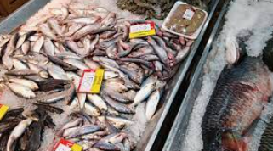


Inventory Counting Systems
Inventory counting systems can be periodic or perpetual.
Periodic
Perpetual
I need to order, every Thursday to get fresh fish on Friday morning
I will order new items if current inventory reach to 10 pieces

Slide 16
Inventory Counting Systems
Under a periodic system, a physical count of items in inventory is made at periodic, fixed intervals (e.g., weekly, monthly) to decide how much to order for each item.
Many small retailers use this approach.
Then, the manager estimates how much will be demanded before the next delivery period and bases the order quantity on that information.
An advantage of this type of system is that orders for many items occur simultaneously, which can result in economies in processing and shipping orders.
There are also several disadvantages of periodic reviews.
One is a lack of control between reviews.
Another is the need to protect against shortages between review periods by carrying extra stock.

Slide 17
Inventory Counting Systems (Contd.)
A perpetual inventory system (also known as a continuous review system) keeps track of removals from inventory continuously so that the system can provide information on the current level of inventory for each item.
When the amount on hand reaches a predetermined minimum, a fixed quantity, Q, is ordered.
An obvious advantage of this system is the control provided by the continuous monitoring of inventory withdrawals.
Another advantage is the fixed-order quantity; management can determine an optimal order quantity.

Slide 18
Inventory Counting Systems (Contd.)
One disadvantage of this approach (Perpetual) is the added cost of record keeping.
Moreover, a physical count of inventories must still be performed periodically to verify records because of possible errors, pilferage, spoilage, and other factors that can reduce inventory effectiveness.

Slide 19
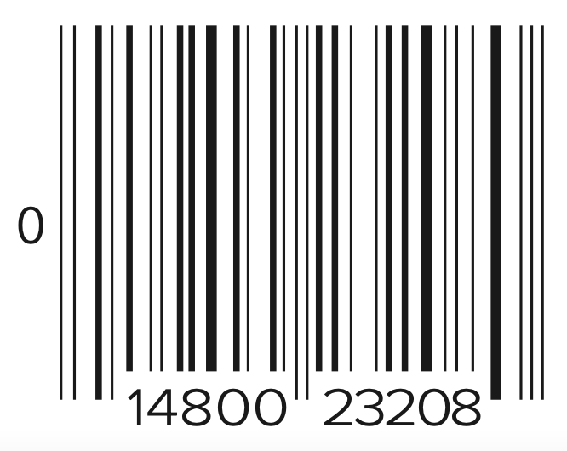
Inventory Counting Systems (Contd.)
Supermarkets, discount stores, and department stores have always been major users of periodic counting systems.
Today, most have switched to computerized checkout systems using a laser scanning device that reads a universal product code (UPC), or bar code, printed on an item tag or on packaging.
A typical grocery product code is illustrated here:
The zero on the left of the bar code identifies this as a grocery item,
the first five numbers (14800) indicate the manufacturer,
the last five numbers (23208) indicate the specific item
Items in small packages, such as candy and gum, use a six-digit number.

Slide 20
Demand Forecasts and Lead-Time Information
Inventories are used to satisfy demand requirements, so it is essential to have reliable estimates of the amount and timing of demand.
Similarly, it is essential to know how long it will take for orders to be delivered.
In addition, managers need to know the extent to which demand and lead time (the time between submitting an order and receiving it) might vary; the greater the potential variability, the greater the need for additional stock to reduce the risk of a shortage between deliveries.
Thus, there is a crucial link between forecasting and inventory management.

Slide 21
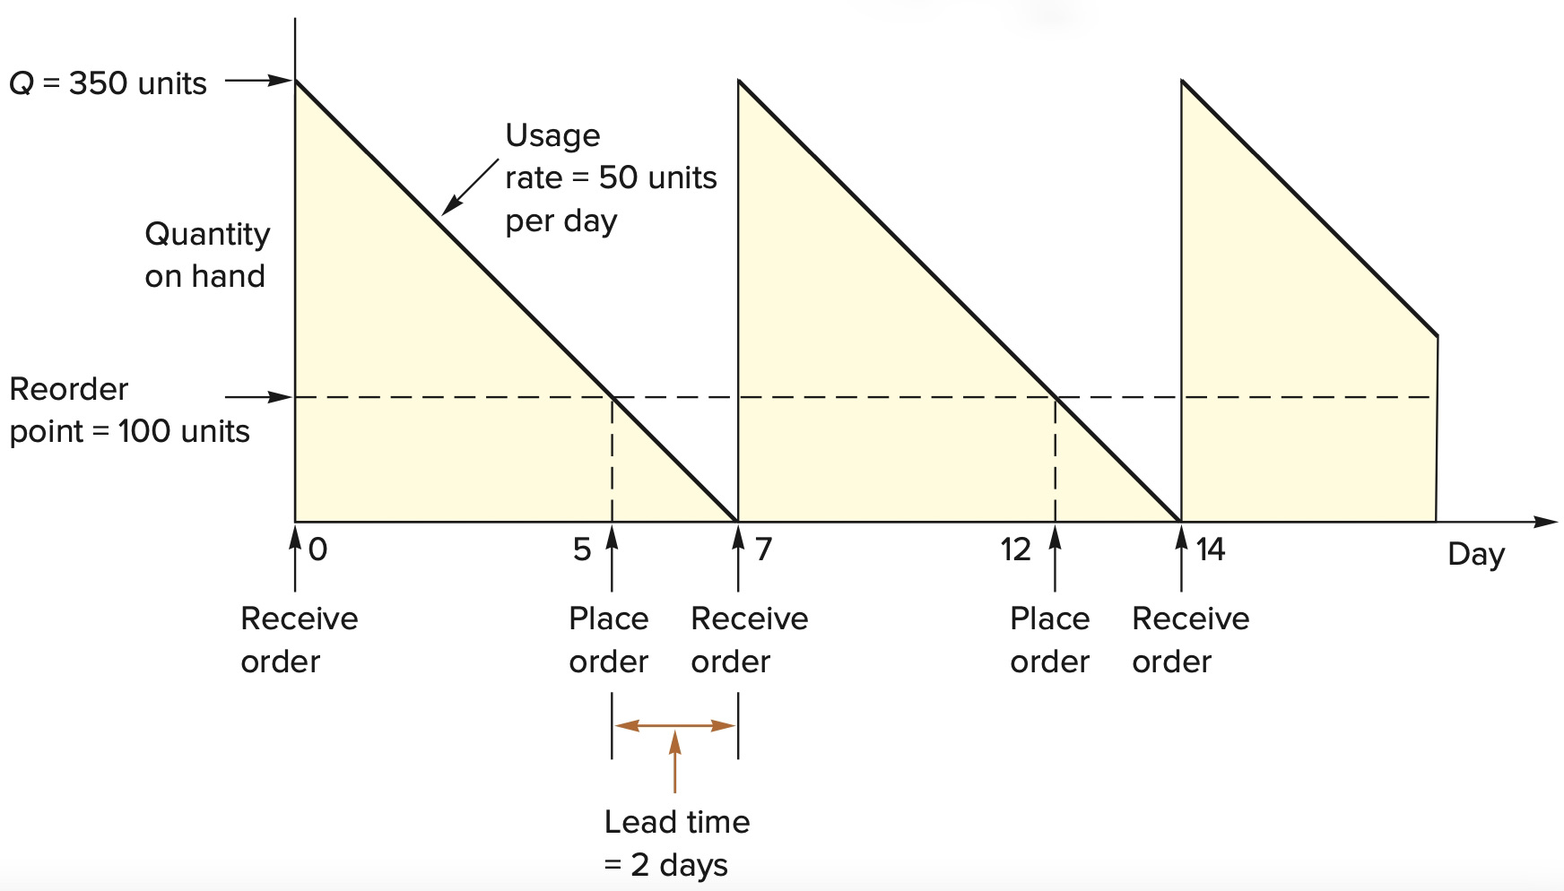

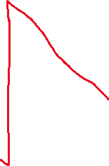

Inventory cycle
19
20
22
Order size, Q = 350 units Usage rate = 50 units per day Lead time = 2 days Reorder point = 100 units (2 days’ supply)

Slide 22
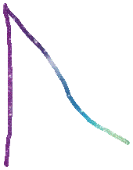

Inventory cycle
Perpetual system: Place order on day 20, order quantity: 350 units
Periodic system: Place order on day 19, order quantity: 300 units
19
20
22
Order size, Q = 350 units Usage rate = 50 units per day Lead time = 2 days Reorder point = 100 units (2 days’ supply)

Slide 23
When to order?
Reorder point (ROP)= demand during lead time
If demand and lead time are both constant,
The reorder point is simply ROP = d × LT
Where,
d = Demand Rate (units per day or week)
LT = Lead time in days or weeks
Note: Demand and lead time must be expressed in the same time units.

Slide 24
When to order?
Reorder point (ROP), The reorder point occurs when the quantity on hand drops to a predetermined amount and the item is reordered. It indicates when to send purchase order an item. More appropriate with perpetual (continuous review) system
Demand (D) = 10,000 yards/year
Store open 311 days/year
Daily demand (d) = 10,000 / 311 = 32.154 yards/day
Lead time = L = 10 days
ROP = dL = (32.154)(10) = 321.54 yards

Slide 25
Inventory Costs
Four basic costs are associated with inventories:
➢ Purchase Costs
➢ Holding Costs
➢ Ordering Costs
➢ Shortage Costs

Slide 26


Inventory Costs
➢ Purchase Costs
Purchase cost is the amount a vendor or supplier pays to buy the inventory.
It can include shipping costs.
Purchase cost is typically the largest of all inventory costs.

Slide 27
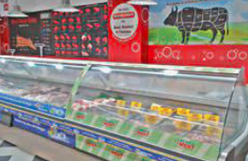
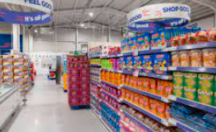
Inventory Costs
➢ Holding Costs (H)
Holding, or carrying, costs relate to physically having items in storage.
Costs include interest, insurance, taxes (in some states), depreciation, obsolescence, deterioration, spoilage, pilferage, breakage, tracking, picking items from inventory, and warehousing costs (heat, light, rent, workers, equipment, security).
They also include opportunity costs associated with having funds that could be used elsewhere tied up in inventory.

Slide 28

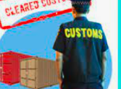


Inventory Costs
➢ Ordering Costs (S)
Ordering costs are the costs of ordering and receiving inventory.
They are the costs that occur with the actual placement of an order.
They include determining how much is needed, preparing invoices, inspecting goods upon arrival for quality and quantity, and moving the goods to temporary storage.
Ordering costs are generally expressed as a fixed dollar amount per order, regardless of order size.

Slide 29
Inventory Costs
➢ Ordering Costs (S) (Contd.)
When a firm produces its own inventory instead of ordering it from a supplier, machine setup costs (e.g., preparing equipment for the job by adjusting the machine, changing cutting tools) are equivalent to ordering costs; that is, they are expressed as fixed charge per production run, regardless of the size of the run.

Slide 30
Inventory Costs
Shortage Costs
Shortage costs result when demand exceeds the supply of inventory on hand.
These costs can include the opportunity cost of not making a sale, loss of customer goodwill, late charges, backorder costs, and similar costs.

Slide 31
HOW MUCH TO ORDER: ECONOMIC ORDER QUANTITY MODELS
The question of how much to order can be determined by using an Economic Order Quantity (EOQ) model.
EOQ models identify the optimal order quantity by minimizing the sum of certain annual costs that vary with order size and order frequency.
How much quantity to bring in order to have minimum cost?
EOQ models answer the question of how much to order, but not the question of when to order.

Slide 32
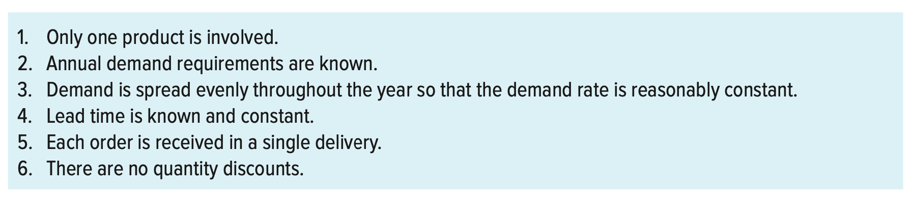
ECONOMIC ORDER QUANTITY MODELS
Assumptions of the Basic EOQ Model

Slide 33
Total carrying cost/holding cost
Average inventory in one inventory cycle= Q/2 = 350/2 = 175
Inventory cycle-3
Inventory cycle-2
Inventory cycle-1

Slide 34
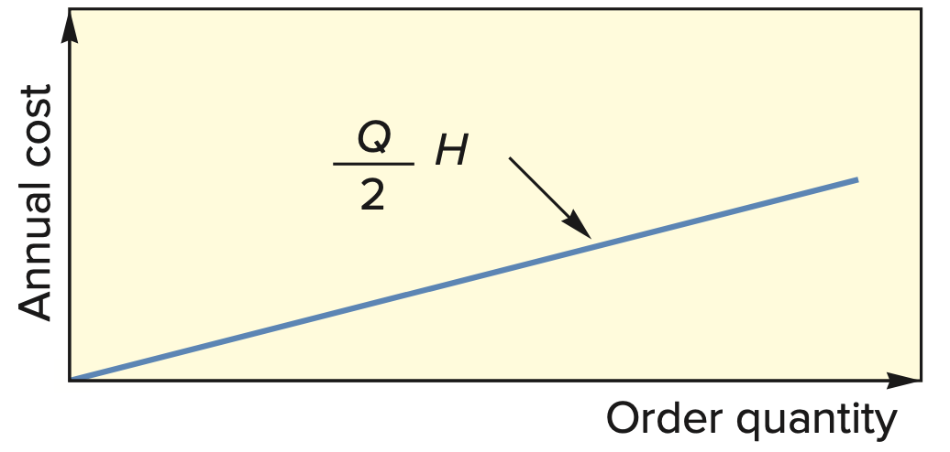
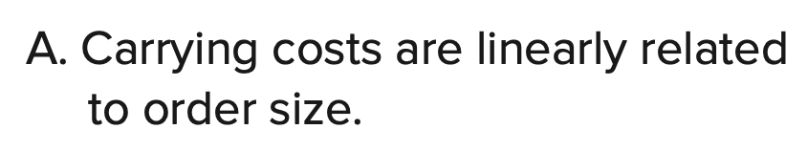
Total carrying cost/holding cost
Q = Order quantity in units
H = Holding (or carrying) cost per unit
Total carrying cost or holding cost = (Q/2).H
Carrying cost is thus a linear function of Q:
Carrying costs increase or decrease in direct proportion to changes in the order quantity Q,

Slide 35
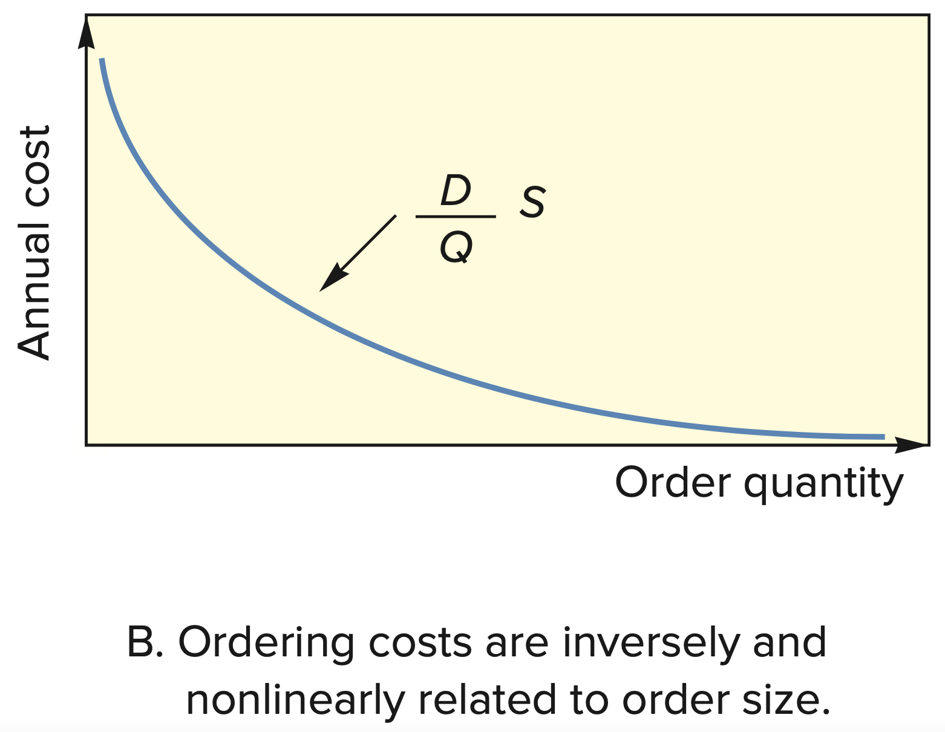
Total ordering cost
Where,
Q = Order quantity in units
D = Demand, in units per year
S = Ordering cost

Slide 36
Total ordering cost
On the other hand, annual ordering costs will decrease as order size increases because, for a given annual demand, the larger the order size, the fewer the number of orders needed.
For instance, if the annual demand is 12,000 units and the order size is 1,000 units per order, there must be 12 orders over the year.
But if Q = 2,000 units, only (D/Q = 12,000/2,000=6) six orders will be needed;
if Q = 3,000 units, only (D/Q = 12,000/3,000=4) four orders will be needed.
For each time, we place order, a fixed cost S =$500 will incur.
So, for Q =2,000, total ordering cost will be 6S = 6 x 500 = $3,000
Q=3,000, total ordering cost will be 4S = 4 x 500 = $2,000

Slide 37
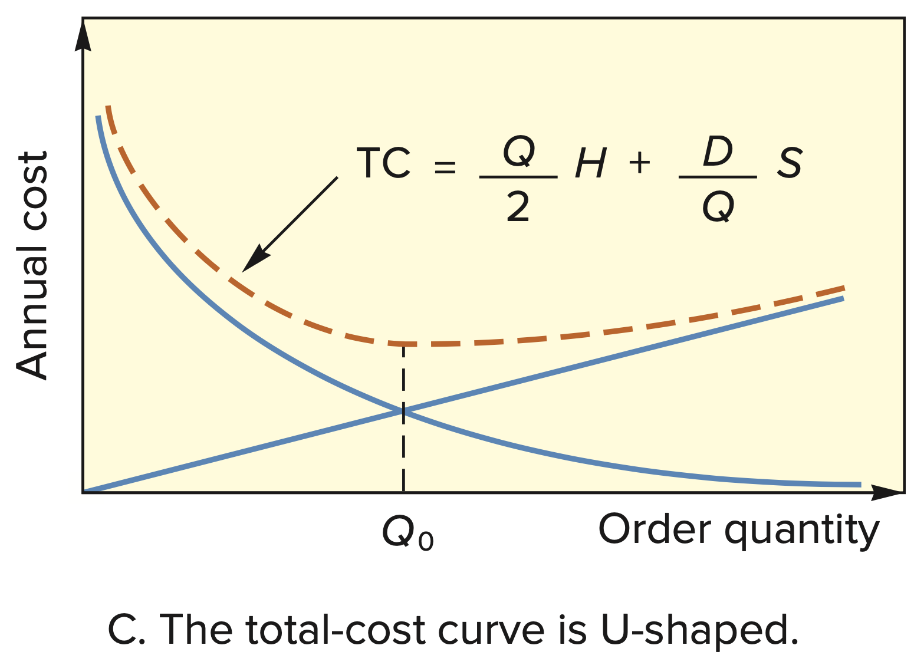
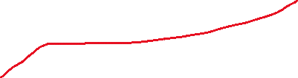
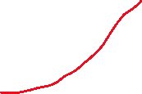
ECONOMIC ORDER QUANTITY MODELS
Total inventory cost (TC) =
Total holding (carrying) cost +
Total ordering cost

Slide 38
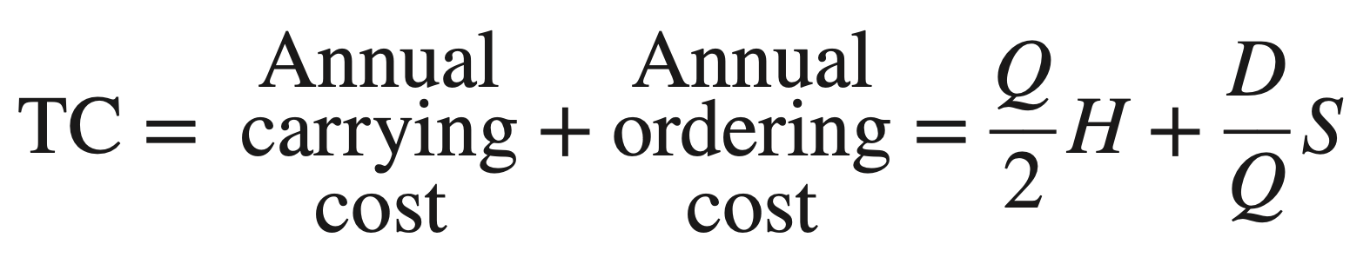
ECONOMIC ORDER QUANTITY MODELS
The total annual cost (TC) associated with carrying and ordering inventory when Q units are ordered each time is

Slide 39
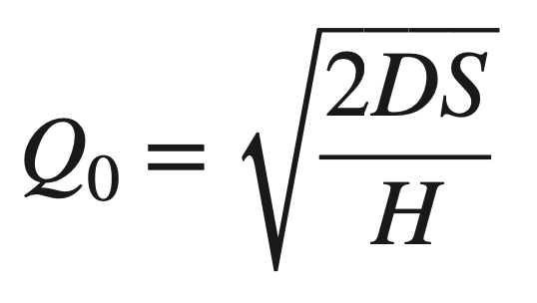
ECONOMIC ORDER QUANTITY MODELS
The diagram reveals that the total-cost curve is U-shaped (i.e., convex, with one minimum) and that it reaches its minimum at the quantity where carrying and ordering costs are equal.
An expression for the optimal order quantity, Q₀, can be obtained using calculus.
The result is the formula is:
Q² H = 2DS

Slide 40
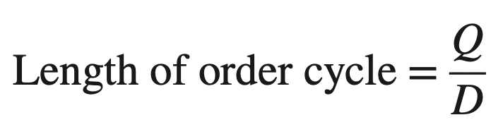
ECONOMIC ORDER QUANTITY MODELS
Thus, given annual demand, the ordering cost per order, and the annual carrying cost per unit, one can compute the optimal (economic) order quantity.
The minimum total cost is then found by substituting Q₀ for Q.
The length of an order cycle (i.e., the time between orders) is:

Slide 41
ECONOMIC ORDER QUANTITY MODELS
Sample Problem # 1
H = $0.75 per yard S= $150 D = 10,000 yards
Lead Time= 7 days
What are EOQ and Minimum Total Cost?
What is the optimum number of orders per year?
What is the length of the order cycle?
What is the reorder point?

Slide 42
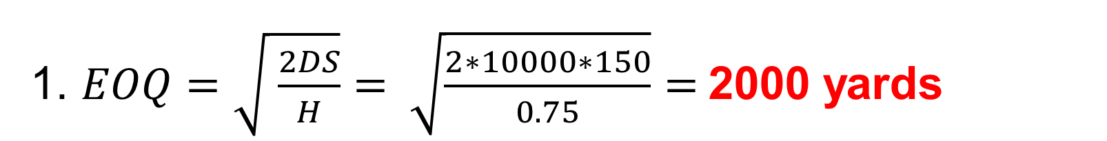


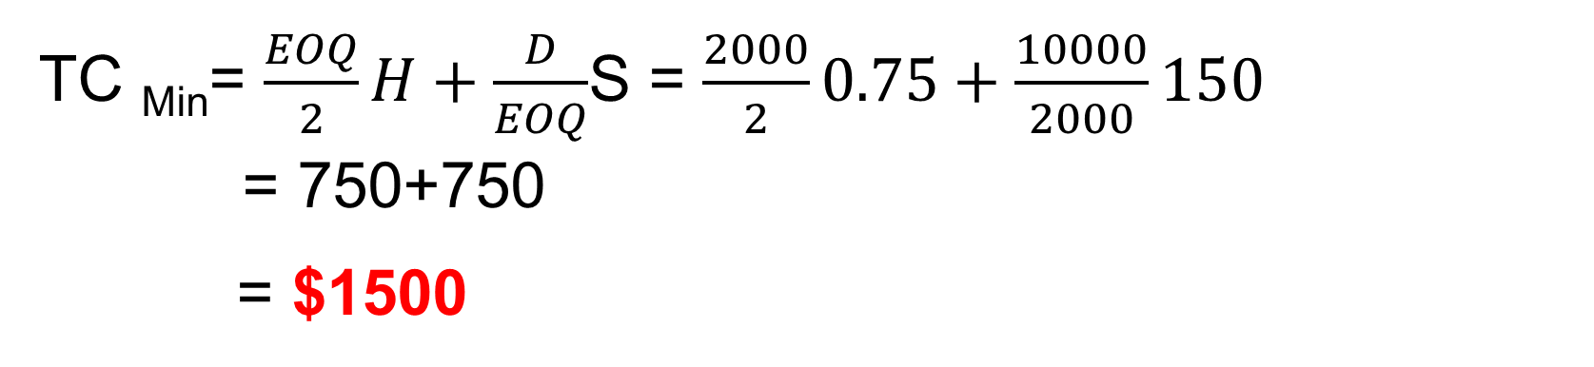
ECONOMIC ORDER QUANTITY MODELS
Solution# 1
H = $0.75 per yard S= $150 D = 10,000 yards Lead Time= 7 days
1. $EOQ=\sqrt{ \frac{2DS}{H}}= \sqrt{\frac{2∗10000∗150}{0.75}}=$2000 yards
TC _{Min}= $\frac{EOQ}{2}H+\frac{D}{EOQ}$S = $\frac{2000}{2}0.75+\frac{10000}{2000}150$
= 750+750
= $1500

Slide 43
ECONOMIC ORDER QUANTITY MODELS
Solution# 1
2. Optimum no. of orders per year = $\frac{D}{EOQ}=\frac{10,000}{2,000}=5 times$
3. Length of the Order Cycle = EOQ/ D
= 2,000 × 365
10,000
= 73 days

Slide 44
ECONOMIC ORDER QUANTITY MODELS
Solution# 1
d = D/365 = 10,000/365 days
= 10,000/365 = 27.40 yards/day
5. ROP = d×LT
= 27.40 × 7
= 191.80 yards

Slide 45
ECONOMIC ORDER QUANTITY MODELS
Summary
If my annual requirement is 10,000 yards at a time, I will place an order of 2,000 yards.
So that I need to place orders for 5 times to meet the annual demand of 10,000 yards.
It will take 73 days to complete the order of 2,000 yards.
When I am placing an order of 2,000 yards at a time, the total cost is minimum at that point and the value will be $1,500.

Slide 46
ECONOMIC ORDER QUANTITY MODELS
Summary (Contd.)
Since nothing is mentioned about the total working days/year, so it can be considered that I will be working on 365 days/ year.
So, the daily demand (d) will be 27.40 yards/day.
Since, the lead time given as 7 days, therefore the Reorder Point (ROP) is 191.80 yards.

Slide 47
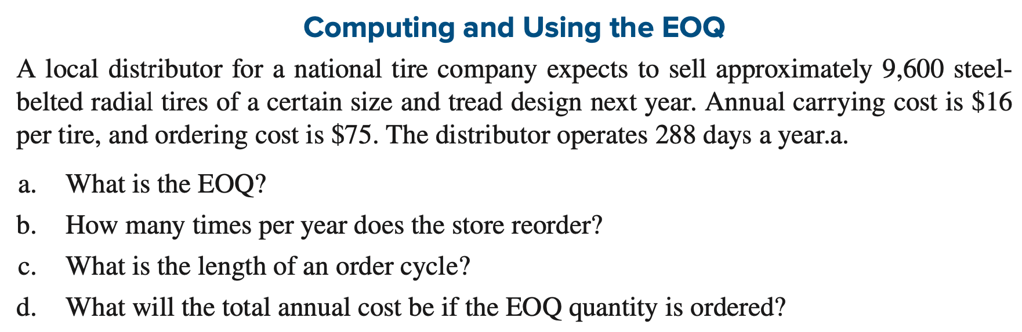
ECONOMIC ORDER QUANTITY MODELS
Sample Problem# 2

Slide 48
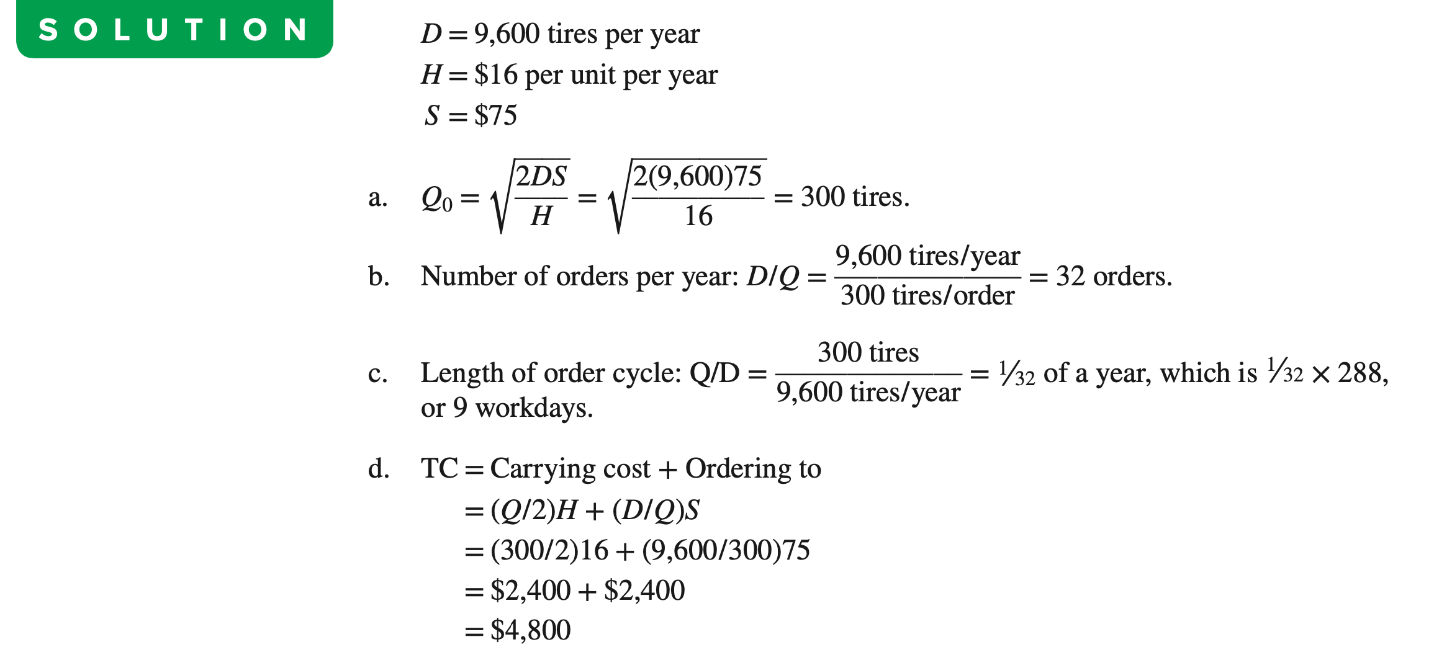
ECONOMIC ORDER QUANTITY MODELS
Solution# 2

Slide 49
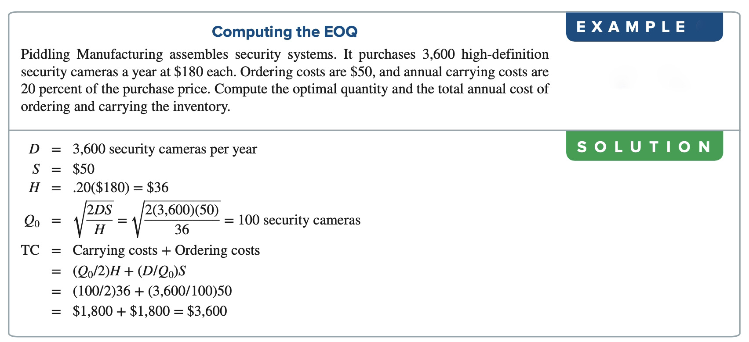
ECONOMIC ORDER QUANTITY MODELS
Sample Problem# 3
Per unit per year

Slide 50
ECONOMIC ORDER QUANTITY MODELS
Sample Problem# 4
One of the top-selling items in the container group at a museum’s gift shop is a bird feeder. Sales are 18 units per week and the supplier charges Tk. 60 per unit. The cost of placing an order is Tk. 45/-. The annual holding cost is 25% of a feeder’s value and the museum operates 52 weeks per year. Management choose a 390 units lot size so that new orders could be placed less frequently.
Identify EOQ.
Determine the annual inventory cost of the current lot size of 390 units.
Determine the annual inventory cost considering the EOQ.
Supplier offer 10% discount on the price if 500 units are ordered. Should the company accept the offer or reject the offer

Slide 51
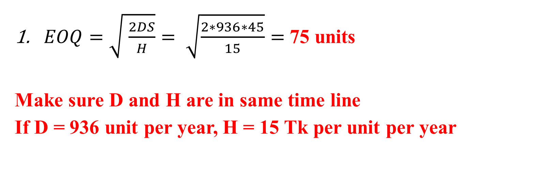
ECONOMIC ORDER QUANTITY MODELS
Solution# 4
Parameters:
Q = 390 units D = 18 × 52 = 936 units
Ordering Cost = S = Tk. 45/- Holding Cost = H = Tk. 60 *25% = Tk. 15/-
$EOQ=\sqrt{ \frac{2DS}{H}}= \sqrt{\frac{2∗936∗45}{15}}=$75 units
Make sure D and H are in same time line
If D = 936 unit per year, H = 15 Tk per unit per year

Slide 52
ECONOMIC ORDER QUANTITY MODELS
Solution# 4
Parameters:
Q = 390 units D = 18 × 52 = 936 units
Ordering Cost = S = Tk. 45/- Holding Cost = H = Tk. 60 *25% = Tk. 15/-
2. Annual Cost (when Q = 390 units)
Number of orders per year = D/Q = 936/390 = 2.4 orders
Annual Holding Cost = (Q/2) × H = (390/2) × 15 = Tk. 2925/-
Annual Ordering Cost = (D/Q) × S = (936/390) × 45 = Tk. 108/-
Annual Inventory Cost = 2925 + 108 = Tk. 3,033/-

Slide 53
ECONOMIC ORDER QUANTITY MODELS
Solution# 4
Parameters:
Q = 390 units D = 18 × 52 = 936 units
Ordering Cost = S = Tk. 45/- Holding Cost = H = Tk. 60 *25% = Tk. 15/-
3. Annual Cost (when Q = EOQ = 75 units)
Number of orders per year = D/EOQ = 936/75 = 12.48 orders
Annual Holding Cost = (EOQ/2) × H = (75/2) × 15 = Tk. 562.50/-
Annual Ordering Cost = (D/EOQ) × S = (936/75) × 45 = Tk. 561.60/-
Annual Inventory Cost = 562.50 + 561.60 = Tk. 1,124.10/-

Slide 54
ECONOMIC ORDER QUANTITY MODELS
Solution# 4
Parameters:
Q = 500 units , EOQ=75 Annual demand, D = 18 × 52 = 936 units
Ordering Cost = S = Tk. 45/-
Holding Cost = H = Tk. 60 *25% = Tk. 15 per unit per year
Product price, P = 60 Tk
Here, purchasing cost is considered because we need to make a comparison with 10% discount on product price
4. Total Annual Cost (At EOQ = 75)
= Total ordering cost + total holding cost + purchasing cost
= (D/Q).S + (Q/2).H + D.P = (936/75). 45 + (75/2). 15 + (936x60) = 57,284 Tk

Slide 55
ECONOMIC ORDER QUANTITY MODELS
Solution# 4
Parameters:
Q = 500 units , Annual demand, D = 18 × 52 = 936 units
Ordering Cost = S = Tk. 45/-
Holding Cost = H = Tk. 60 *25% = Tk. 15 per product per year
Product price (10% discount), P = 60 x 0.9 = 54 Tk
Here, purchasing cost is considered because we need to make a comparison with 10% discount on product price
Total Annual Cost (when Q = 500)
= Total ordering cost + total holding cost + purchasing cost
= (D/Q).S + (Q/2).H + D.P = (936/500). 45 + (500/2). 15 + (936x54) = 54,378 Tk

Slide 56
ECONOMIC ORDER QUANTITY MODELS
Solution# 4
The total annual cost at (Q= 500) < Total annual cost at (Q = 75)
So, company should take the discounted offer and purchase 500 units at a time

Slide 57
END OF THE CHAPTER…

